Slide 1
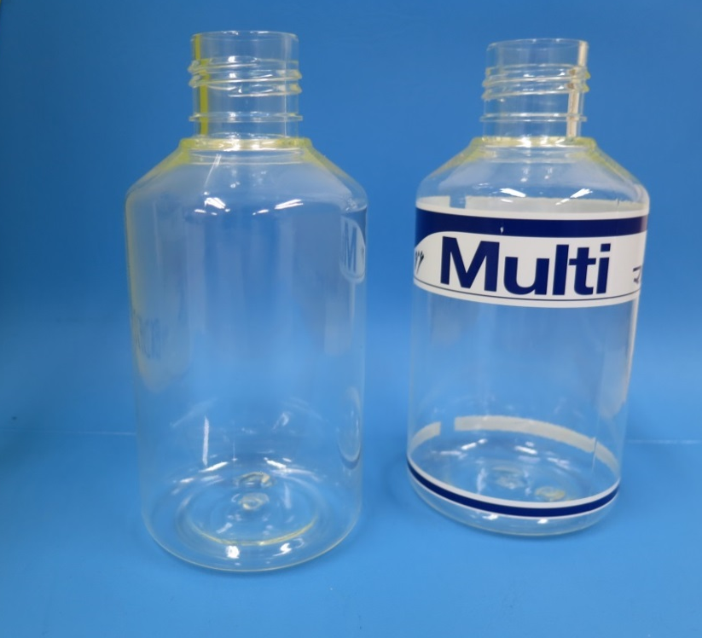
EMS Materials for 380 Stretch Blow Molding (Non-food) Paint bottle
Material: Grivory G21
Requirements/Success
Transparency
Chemical resistance
Impact strength
Tier1: Giver Life OEM: Nippon Paint

Slide 2
EMS Materials for 380 Stretch Blow Molding (Non-food) Paint bottle
SOP: 2016
Pot: 20t/a
Development time: 1 year
Resp. Sales: J. Yokokawa
Application Description: Bottle of paint for automobile
Project History: Replacement from BALEX. Chemical resistance and drop impact strength was necessary. Blow molding was difficult but solved by adjustment of heater temperature and blow conditions.
This information only for internal use

